Slide 1
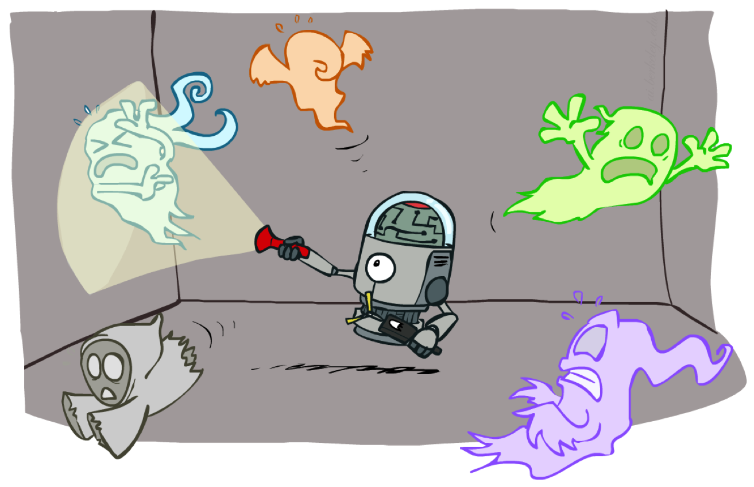
CS 188: Artificial Intelligence
Dynamic Bayes Nets and Particle Filters
Instructor: Stuart Russell and Peyrin Kao
University of California, Berkeley
Notes:
Please retain proper attribution, including the reference to ai.berkeley.edu. Thanks!

Slide 2
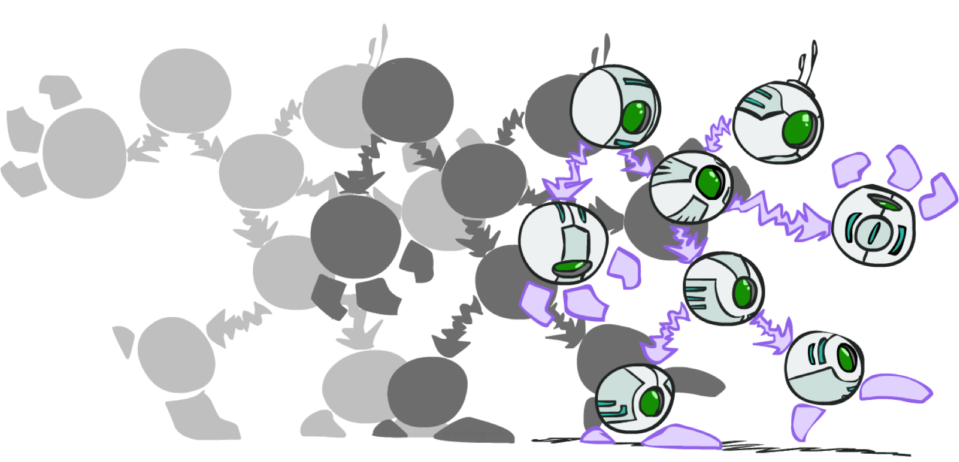
Dynamic Bayes Nets

Slide 3
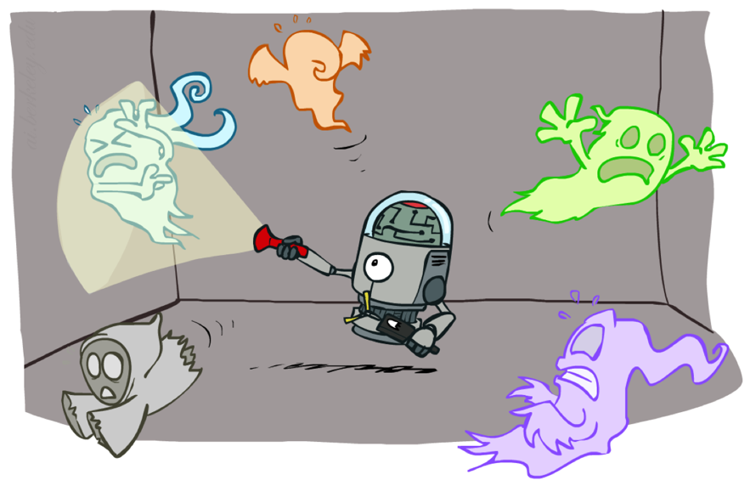
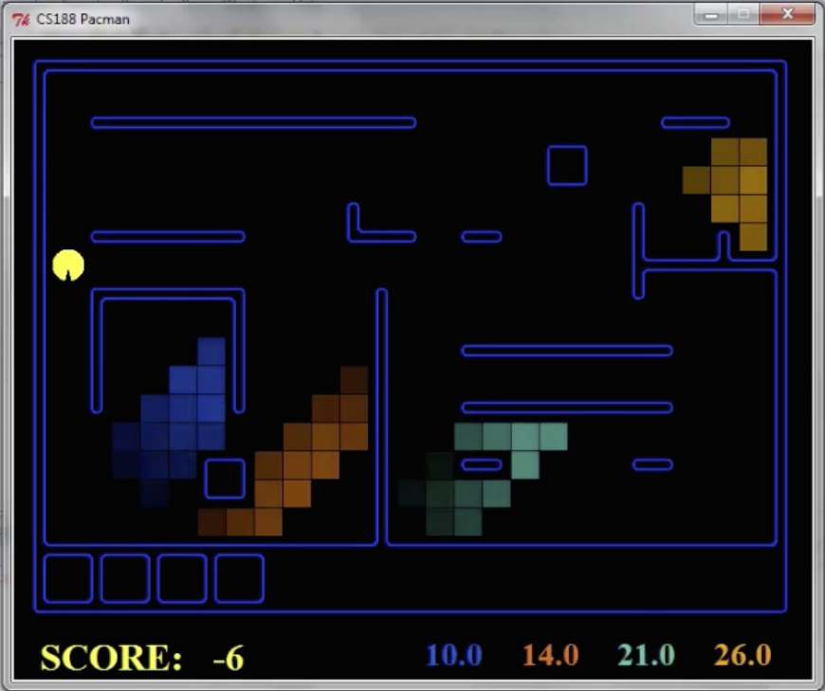
Dynamic Bayes Nets (DBNs)
We want to track multiple variables over time, using multiple sources of evidence
Idea: Repeat a fixed Bayes net structure at each time
Variables at time t can have parents at time t-1
t =1
t =2
t =3
G₁ª
G₂ª
G₃ª
G₁^{b}
G₂^{b}
G₃^{b}
E₁ª
E₁^{b}
E₂ª
E₂^{b}
E₃ª
E₃^{b}

Slide 4
DBNs and HMMs
Every HMM is a single-variable DBN
Every discrete DBN is an HMM
HMM state is Cartesian product of DBN state variables
Sparse dependencies => exponentially fewer parameters in DBN
E.g., 20 Boolean state variables, 3 parents each;
DBN has 20 x 2³ = 160 parameters, HMM has 2²⁰ x 2²⁰ =~ 10¹² parameters
X_{t}
X_{t+1}
Y_{t}
Y_{t+1}
XYZ_{t}
XYZ_{t+1}
Z_{t}
Z_{t+1}

Slide 5
Exact Inference in DBNs
Variable elimination applies to dynamic Bayes nets
Offline: “unroll” the network for T time steps, then eliminate variables to find P(X_{T}|e_{1:T})
Online: eliminate all variables from the previous time step; store factors for current time only
Problem: largest factor contains all variables for current time (plus a few more)
t =1
t =2
t =3
G₁ª
G₂ª
G₃ª
G₃^{b}
G₁^{b}
G₂^{b}
G₃^{b}
E₁ª
E₁^{b}
E₂ª
E₂^{b}
E₃ª
E₃^{b}

Slide 6
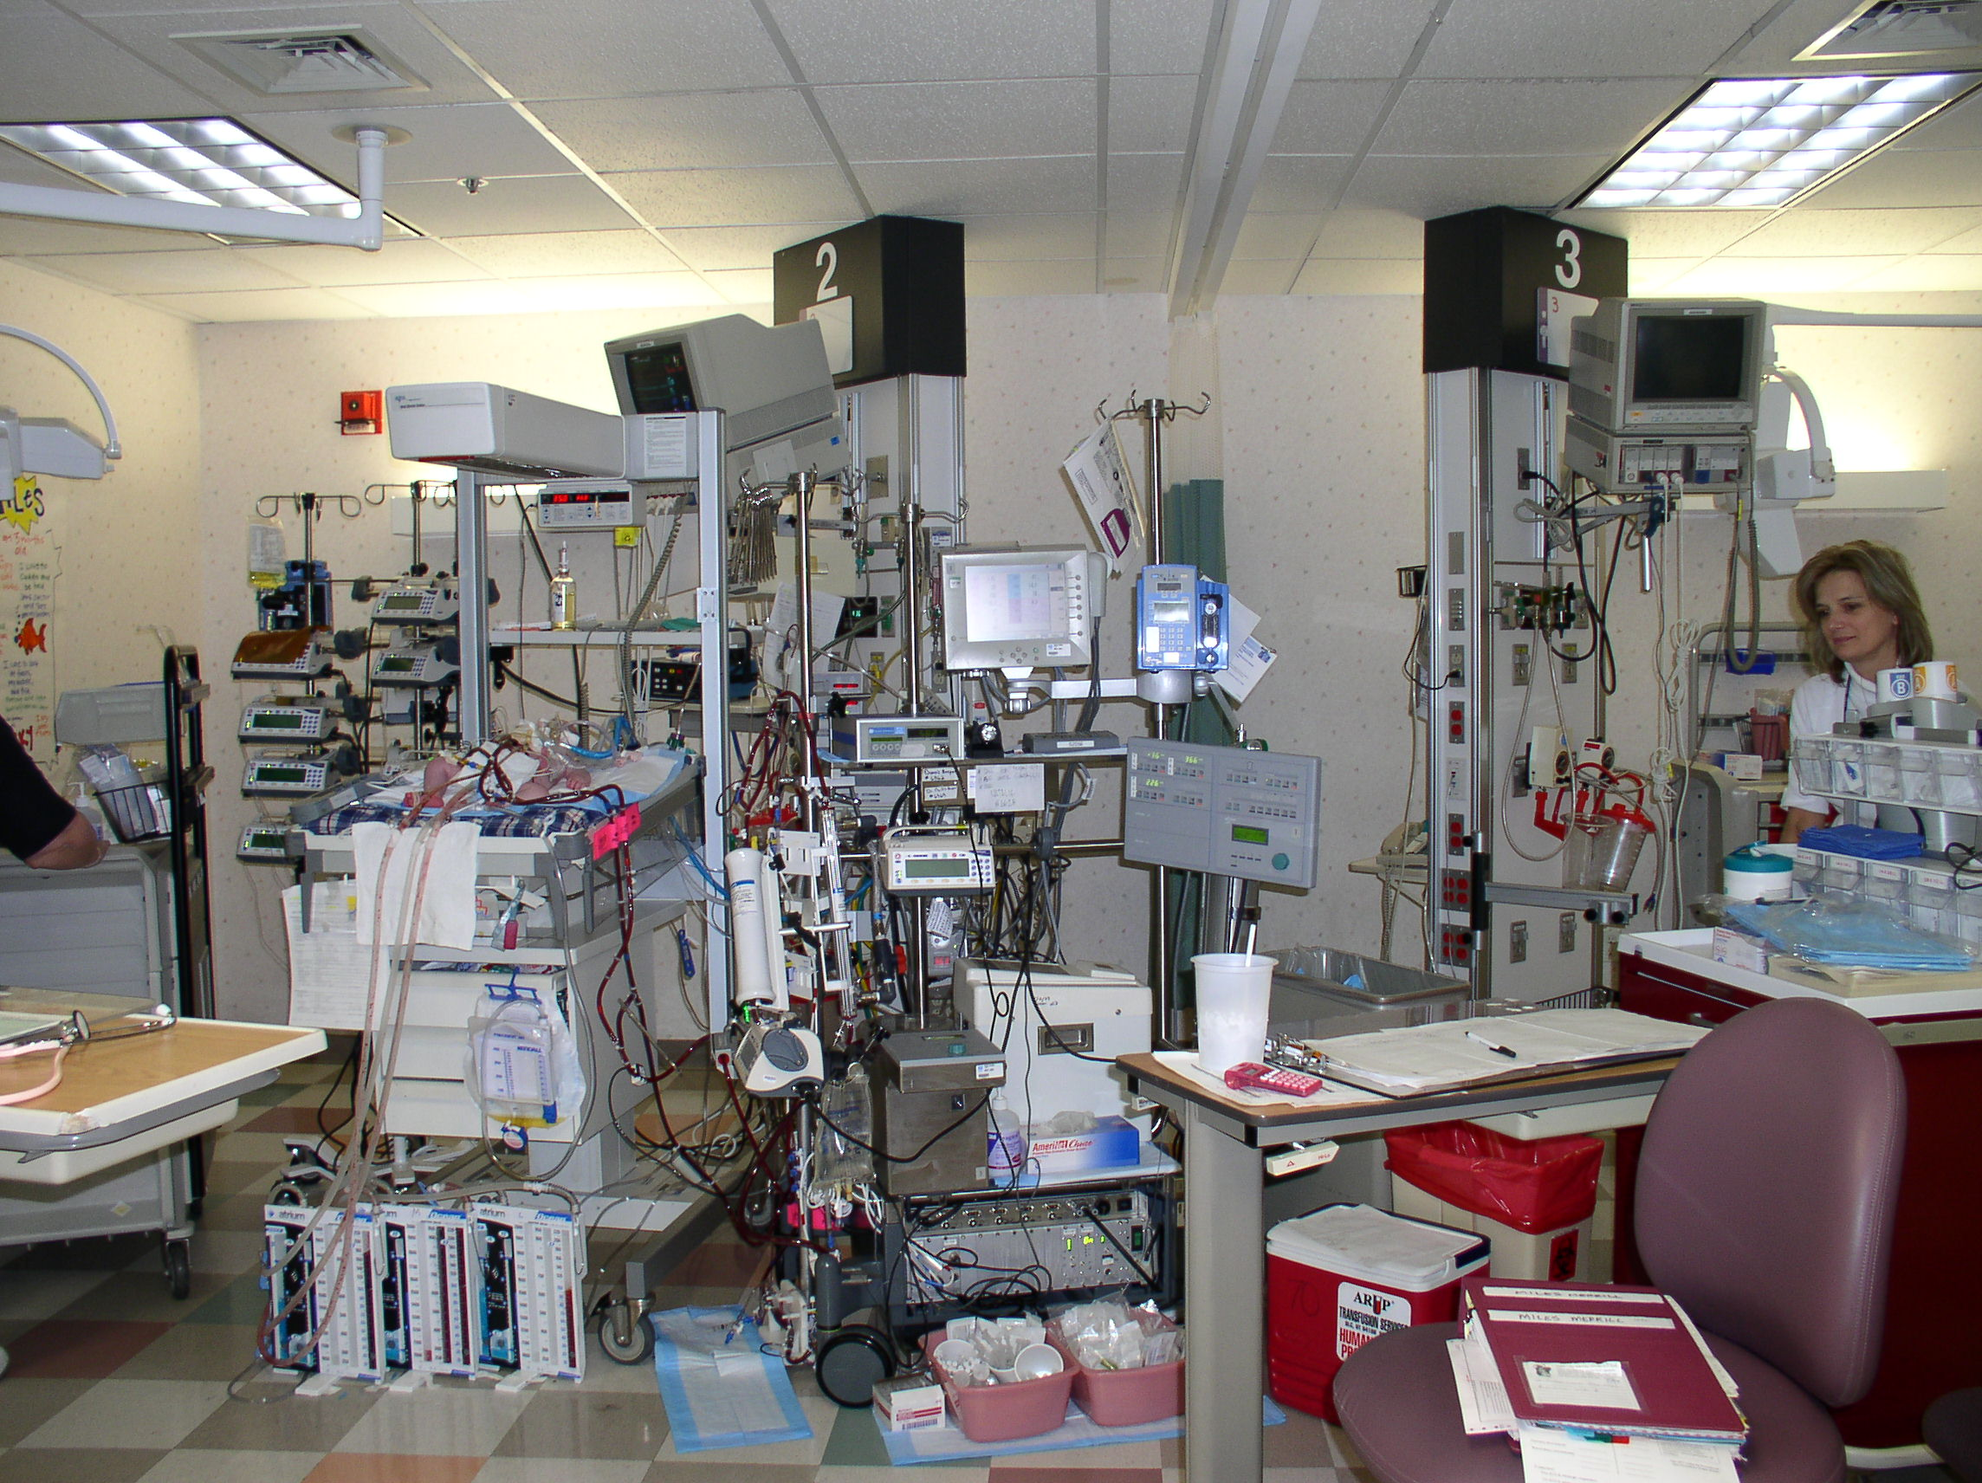
Notes:
This is what an ICU looks like: ventilator, fluids, monitors;
~200 medical procedures per day, many potentially fatal

Slide 7
Application: ICU monitoring
State: variables describing physiological state of patient
Evidence: values obtained from monitoring devices
Transition model: physiological dynamics, sensor dynamics
Query variables: pathophysiological conditions (a.k.a. bad things)

Slide 8
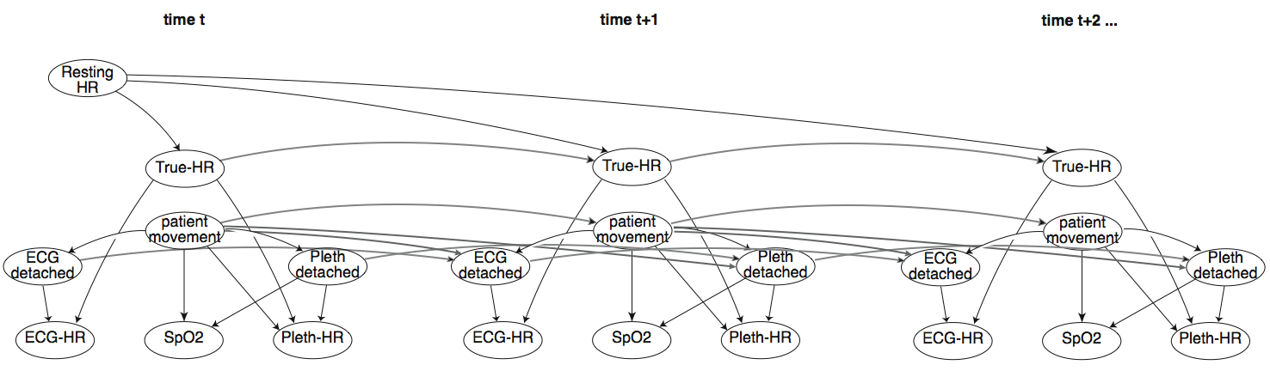
Toy DBN: heart rate monitoring
parameter variable
state variable
sensor variable
sensor state variable

Slide 9
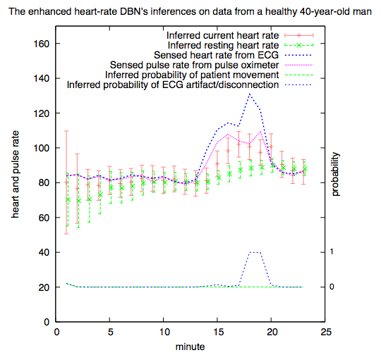
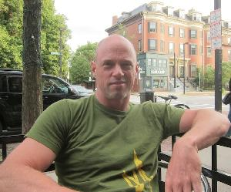

Slide 10
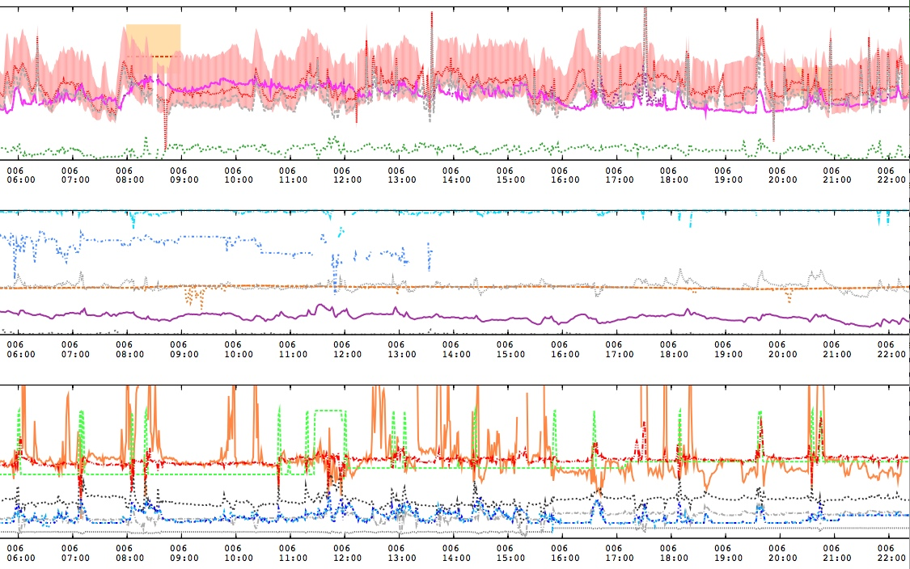
ICU data: 22 variables, 1min ave

Slide 11
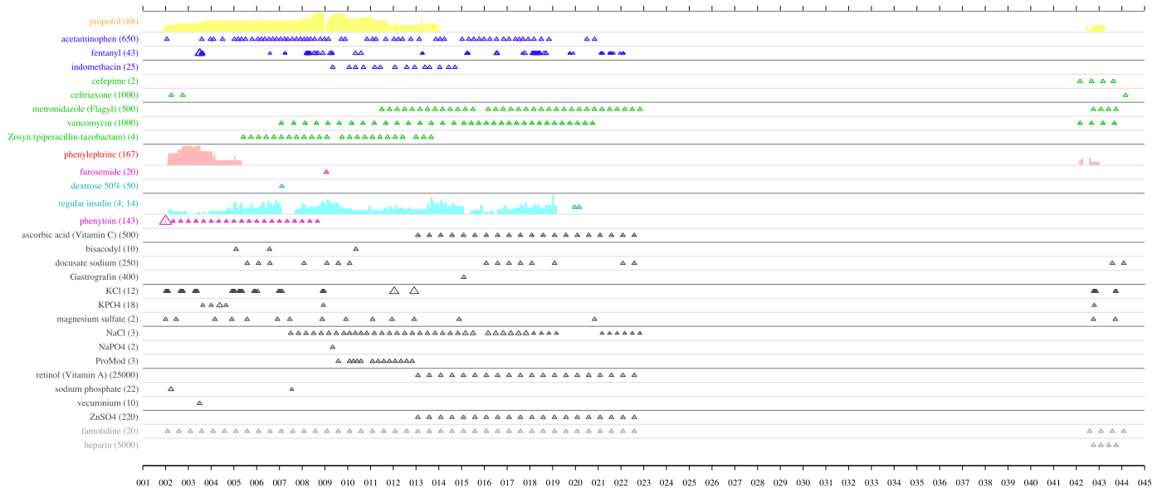

Slide 12
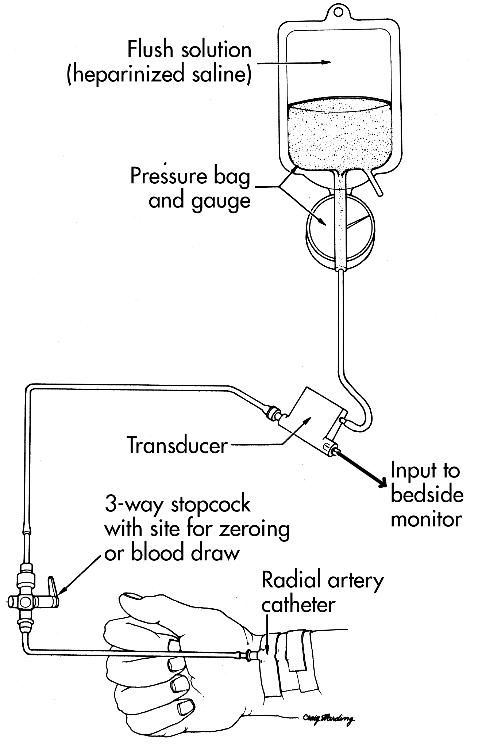
Blood pressure measurement

Slide 13
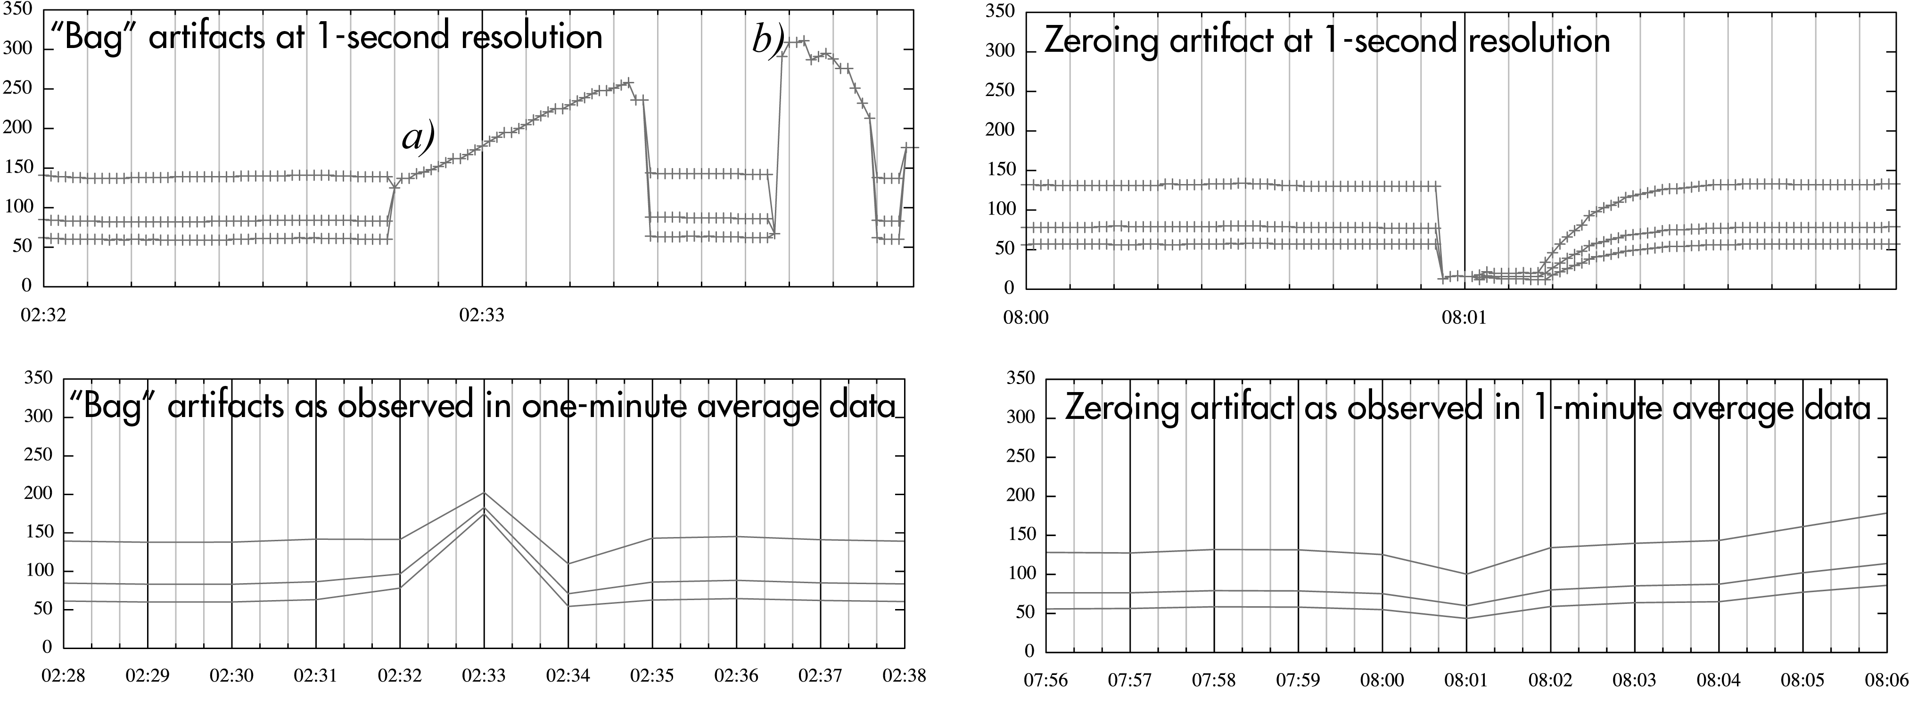
One-second vs one-minute data

Slide 14
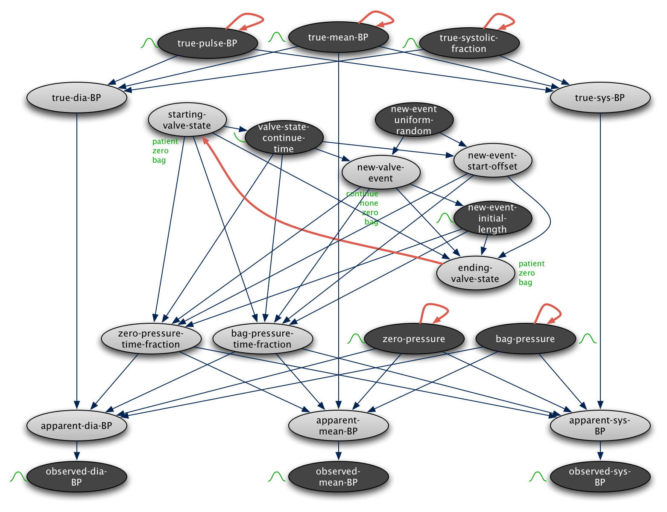
Notes:
A DBN that reflects that model, along with probabilistic occurrence and blood-pressure transition models
14

Slide 15
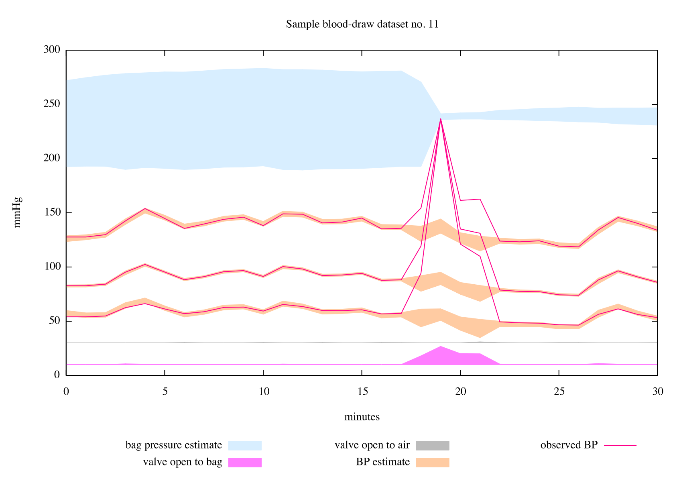
Notes:
Maybe another from Diane?
15

Slide 16
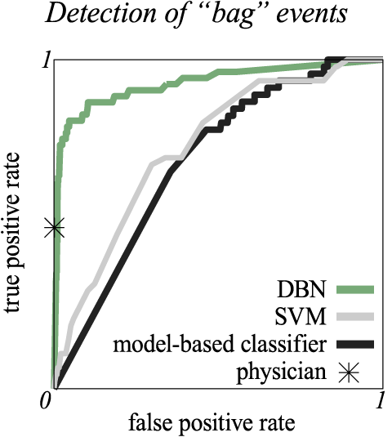
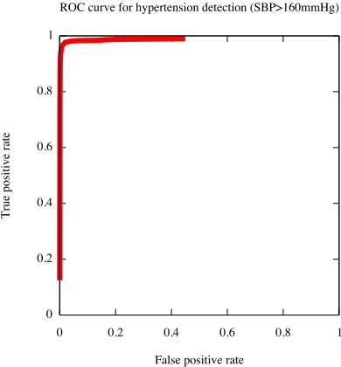

Slide 17
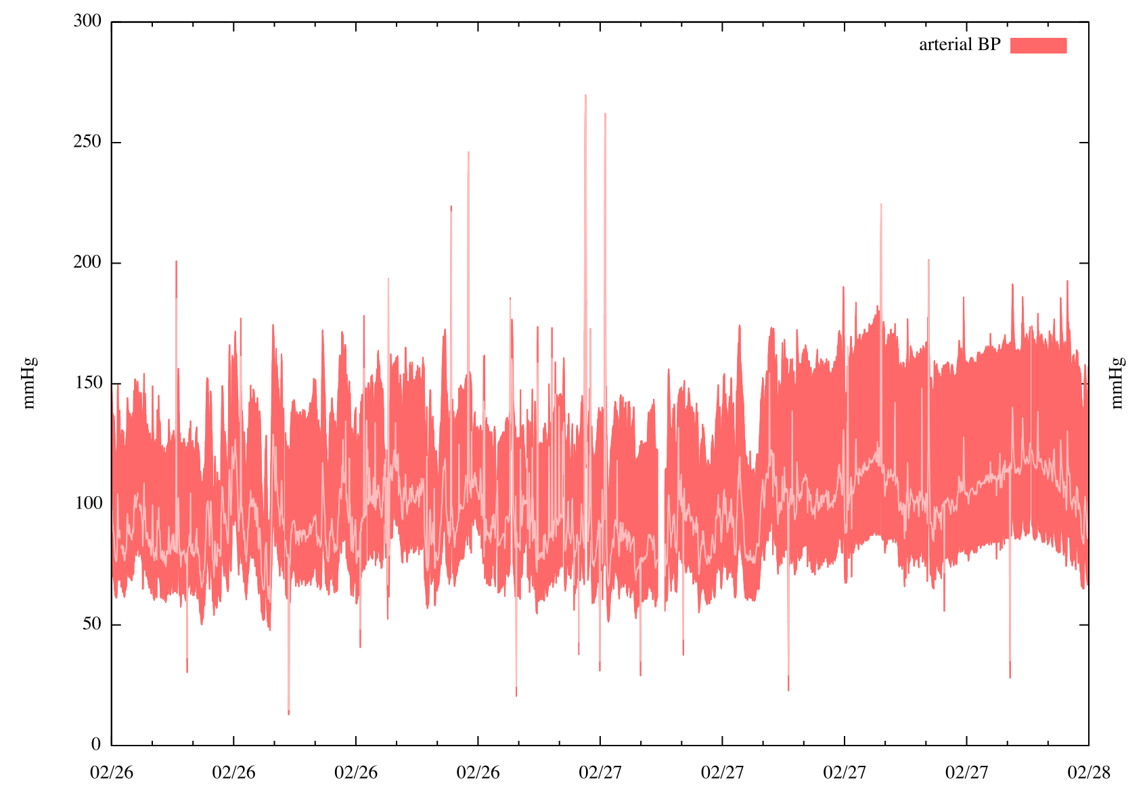
ALARM
Notes:
2 days, 19 false alarms, 7 true alarms, 1 false+true; all correct
17

Slide 18
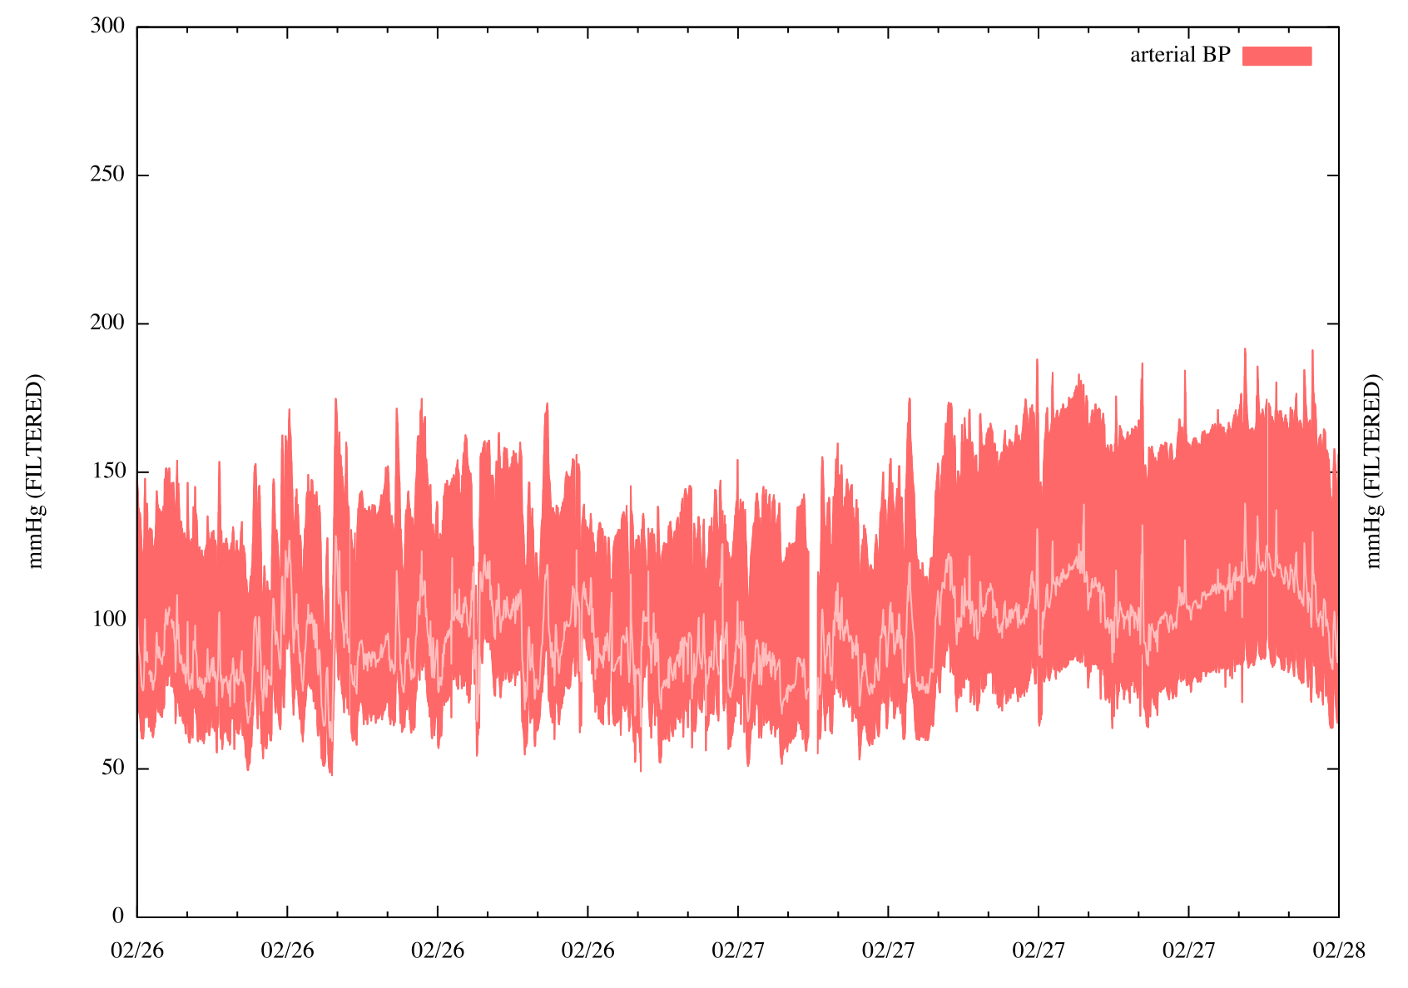
Notes:
Zoomed in, filtered. When done, segue: when does this do poorly? When blood pressure changes quickly – because the blood pressure transition doesn’t allow for it (and if I make it broader, artifacts aren’t detected). System needs more knowledge of blood pressure physiology (and some redundant data, say from heart rate, would be useful too). How to do this?
18

Slide 19
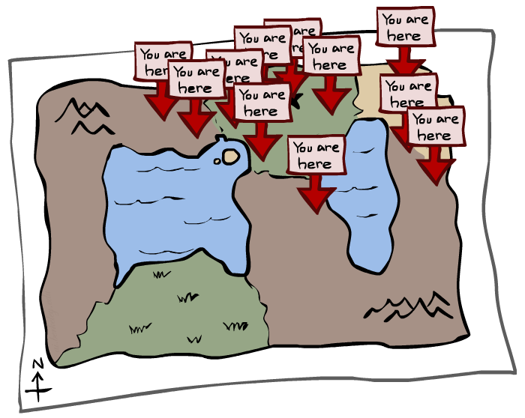
Particle Filtering

Slide 20
We need a new algorithm!
When |X| is more than 10⁶ or so (e.g., 3 ghosts in a 10x20 world), exact inference becomes infeasible
Likelihood weighting fails completely – number of samples needed grows exponentially with T
X₀
X₁
X₂
X₃
E₁
E₂
E₃

Slide 21
We need a new idea!
t=2
t=7
The problem: sample state trajectories go off into low-probability regions, ignoring the evidence; too few “reasonable” samples
Solution: kill the bad ones, make more of the good ones
This way the population of samples stays in the high-probability region
This is called resampling or survival of the fittest

Slide 22
Particle Filtering
Represent belief state by a set of samples
Samples are called particles
Time per step is linear in the number of samples
But: number needed may be large
This is how robot localization works in practice
0.01
0
0.1
0.1
0.03
0
0.01
0
0.03
0
0.2
0.2
0.02
0
0.2
0.2
0.4
0.5

Slide 23
Representation: Particles
Our representation of P(X) is now a list of N << |X| particles
P(x) approximated by number of particles with value x
So, many x may have P(x) = 0 !
More particles => more accuracy (cf. frequency histograms)
Usually we want a low-dimensional marginal
E.g., “Where is ghost 1?” rather than “Are ghosts 1,2,3 in [2,6], [5,6], and [8,11]?”
Particles:
(3,3)
(2,3)
(3,3)
(3,2)
(3,3)
(3,2)
(1,2)
(3,3)
(3,3)
(2,3)

Slide 24
Particle Filtering: Prediction step
Particles:
(3,3)
(2,3)
(3,3)
(3,2)
(3,3)
(3,2)
(1,2)
(3,3)
(3,3)
(2,3)
Particle j in state x_{t}^{(j)} samples a new state directly from the transition model:
x_{t+1}^{(j)} ~ P(X_{t+1} | x_{t}^{(j)})
Here, most samples move clockwise, but some move in another direction or stay in place
Particles:
(3,2)
(2,3)
(3,2)
(3,1)
(3,3)
(3,2)
(1,3)
(2,3)
(3,2)
(2,2)

Slide 25
Particle Filtering: Update step
Particles:
(3,2)
(2,3)
(3,2)
(3,1)
(3,3)
(3,2)
(1,3)
(2,3)
(3,2)
(2,2)
After observing e_{t+1} :
As in likelihood weighting, weight each sample based on the evidence
w^{(j)} = P(e_{t+1}| x_{t+1}^{(j)})
Particles that fit the data better get higher weights, others get lower weights
Normalize the weights across all particles
Particles:
(3,2) w=.9
(2,3) w=.2
(3,2) w=.9
(3,1) w=.4
(3,3) w=.4
(3,2) w=.9
(1,3) w=.1
(2,3) w=.2
(3,2) w=.9
(2,2) w=.4
X .17
X .04
X .17
X .08
X .08
X .17
X .02
X .04
X .17
X .08

Slide 26
Particle Filtering: Resample
Particles:
(3,2) w=.17
(2,3) w=.04
(3,2) w=.17
(3,1) w=.08
(3,3) w=.08
(3,2) w=.17
(1,3) w=.02
(2,3) w=.04
(3,2) w=.17
(2,2) w=.08
Rather than tracking weighted samples, we resample
N times, we choose from our weighted sample distribution (i.e., draw with replacement)
Now the update is complete for this time step, continue with the next one (with weights reset to 1/N)
(New) Particles:
(3,2)
(2,2)
(3,2)
(2,3)
(3,3)
(3,2)
(1,3)
(2,3)
(3,2)
(3,2)

Slide 27
Summary: Particle Filtering
Particles: track samples of states rather than an explicit distribution
Prediction
Update/Weight
Resample
Particles:
(3,3)
(2,3)
(3,3)
(3,2)
(3,3)
(3,2)
(1,2)
(3,3)
(3,3)
(2,3)
Particles:
(3,2)
(2,3)
(3,2)
(3,1)
(3,3)
(3,2)
(1,3)
(2,3)
(3,2)
(2,2)
Particles:
(3,2) w=.9
(2,3) w=.2
(3,2) w=.9
(3,1) w=.4
(3,3) w=.4
(3,2) w=.9
(1,3) w=.1
(2,3) w=.2
(3,2) w=.9
(2,2) w=.4
(New) Particles:
(3,2)
(2,2)
(3,2)
(2,3)
(3,3)
(3,2)
(1,3)
(2,3)
(3,2)
(3,2)
Consistency: see proof in AIMA Ch. 14

Slide 28
Particle filtering on umbrella model

Slide 29
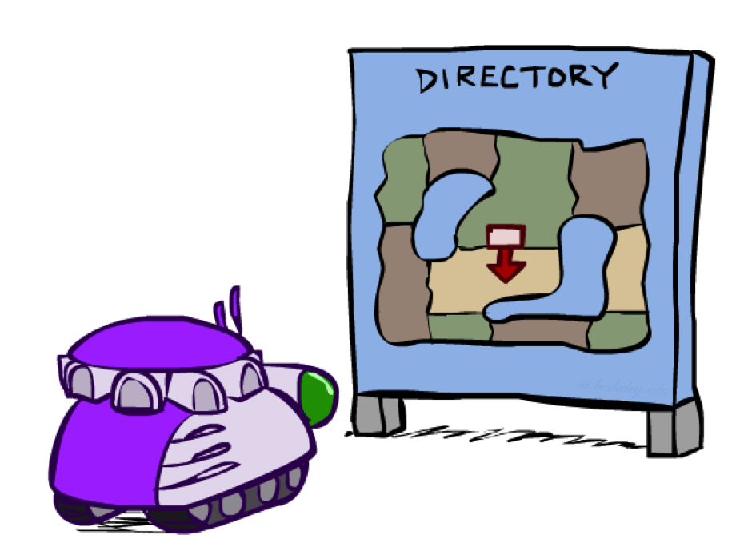
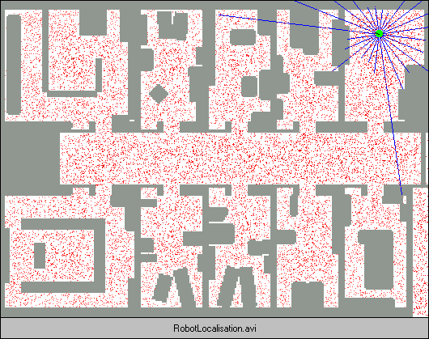
Robot Localization
In robot localization:
We know the map, but not the robot’s position
Observations may be vectors of range finder readings
State space and readings are typically continuous so we cannot usually represent or compute an exact posterior
Particle filtering is a main technique

Slide 30
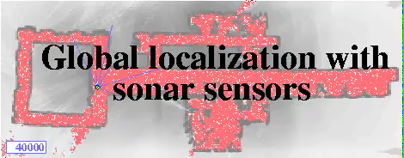
Particle Filter Localization (Sonar)
[Video: global-sonar-uw-annotated.avi]
Notes:
Around 55s switches to another mode of the multimodal distribution

Slide 31
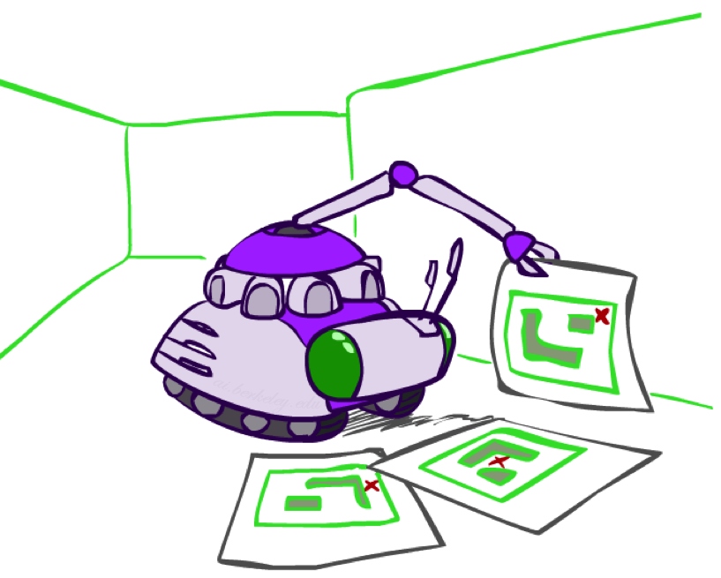
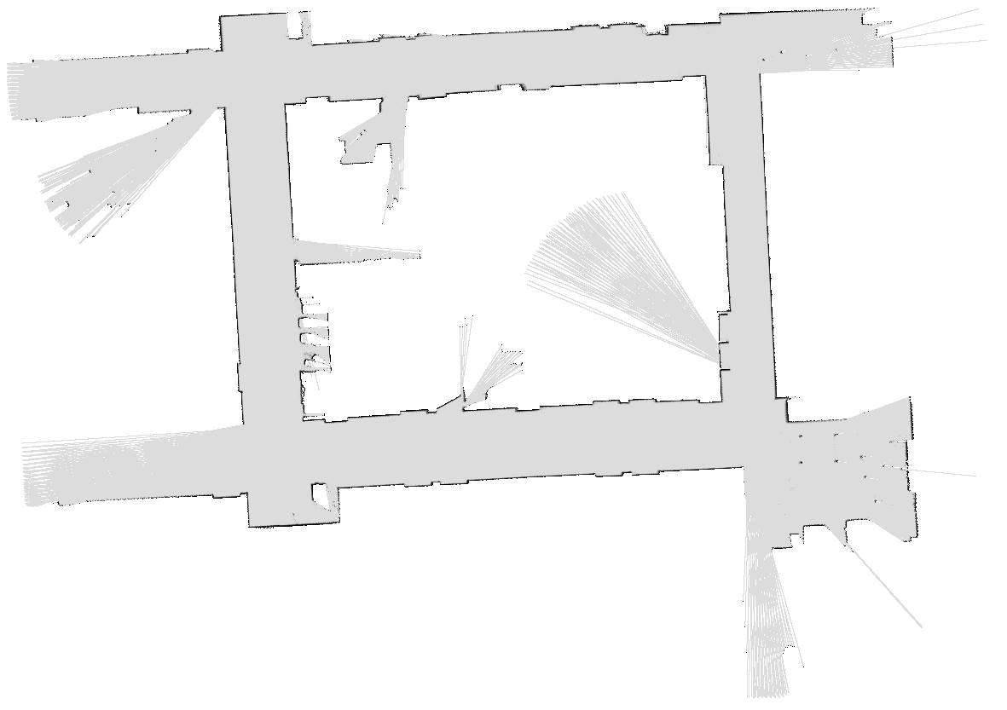
Robot Mapping
SLAM: Simultaneous Localization And Mapping
Robot does not know map or location
State x_{t}^{(j)} consists of position+orientation, map!
(Each map usually inferred exactly given sampled position+orientation sequence: RBPF)
DP-SLAM, Ron Parr

Slide 32
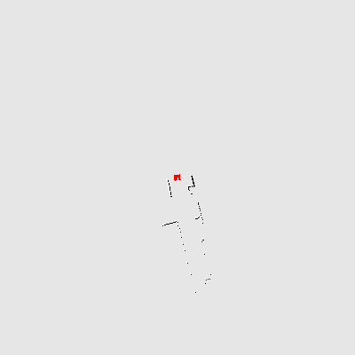
Particle Filter SLAM – Video 1
[Demo: PARTICLES-SLAM-mapping1-new.avi]

Slide 33

Particle Filter SLAM – Video 2
[Demo: PARTICLES-SLAM-fastslam.avi]

